Slide 2
Taking Hold of the Covenant in the 21st Century

Slide 3
On Tap…
Taking hold of the Covenant:
What does that mean?
What kind of Presentation is this?
For those who know everything
“What’s the Cost”
You won’t remember everything – And that’s OK!
Notes:
What kind of presentation
From the perspective of being in the covenant

Slide 4
On Tap…
The Bible: Archaeology and the 53
The Plan of God according to the Bible
Bad Decisions
Good Decisions
Political Activism

Slide 5
On Tap…
Before Marriage
The Role of Women in the Assembly
Miscellaneous
What are you taking home from this presentation?

Slide 6
Archaeology
The Bible: Archaeology and the 53
BAR
Notes:
1820
1920
2020

Slide 7
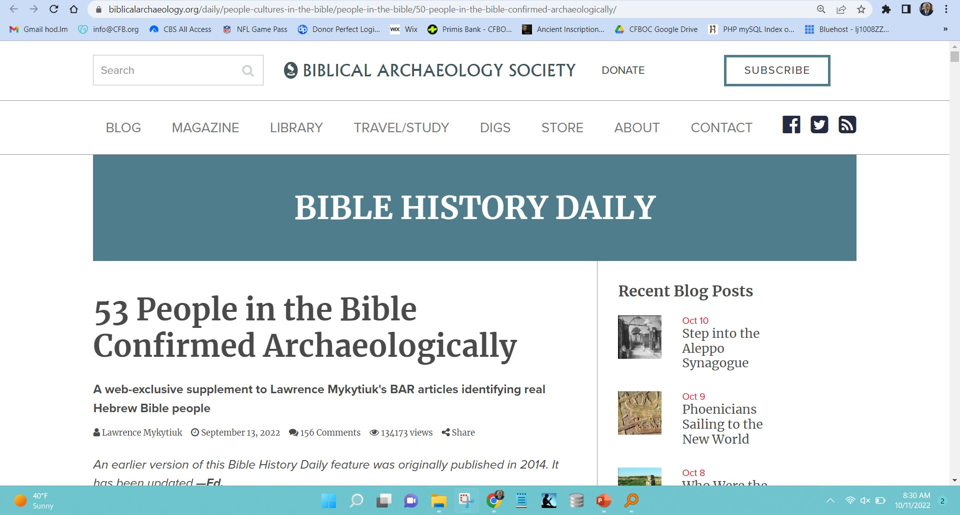

Slide 8
The Plan of God
From the end goal – A Family
Everyone treats each other properly
Everyone treats creation properly
In a nutshell…
Notes:
Free will or robots
Arrive home – Alexia, speaking for the house, says, “I love you”.
Everyone has these drives…
Leads us into decision making

Slide 9
God Speaking?
Imagine all the people
Livin’ life in peace
You may say I’m a dreamer
But I’m not the only one
I hope someday you’ll join us
And the world will be as one
Imagine – The Beatles

Slide 10
The Plan of God
From the end goal – A Family
Everyone treats each other properly...
Everyone treats creation properly
Imagine – The Beatles –
Free will or robots?
Everyone has these drives...
Notes:
Free will or robots
Arrive home – Alexia, speaking for the house, says, “I love you”.
Everyone has these drives…
Leads us into decision making

Slide 11
Decision Making
Making decisions is a part of life
Options:
Good Decisions
Bad Decisions
Example: Bathing suit at the cabin
Other bad examples…

Slide 12
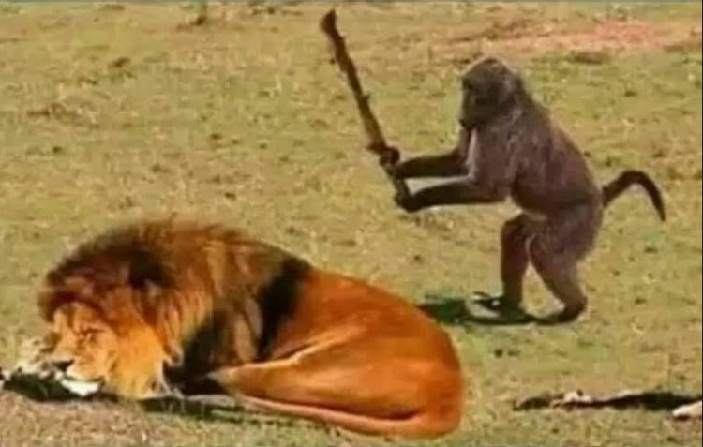
Notes:
Move from animal kingdom to the human kingdom

Slide 18
Patience & Wisdom
A great example of a Good Decision

Slide 19
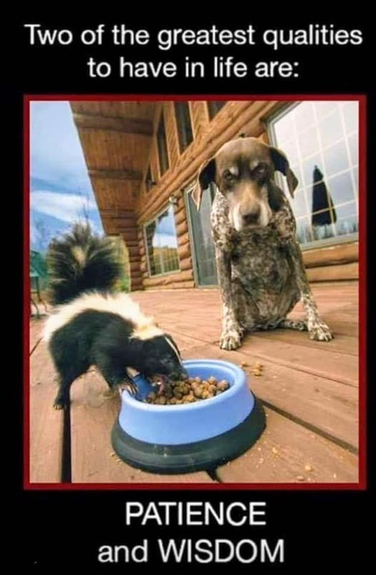

Slide 20
Political Activism
Having taken hold of the Covenant, you can be sure the government will tell you what to do and what not to do.
It’s up to you to “Count the Cost” if you choose not to comply.
Notes:
Next slide
“For the record”…

Slide 21
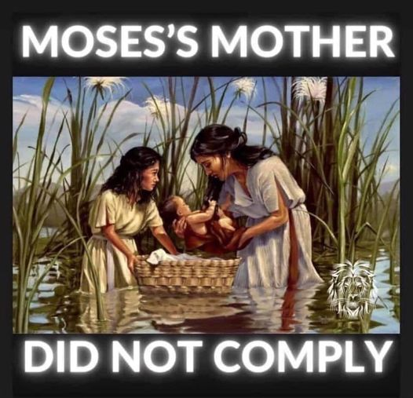

Slide 22
Political Activism
Having taken ahold of the Covenant, you can be sure the government will tell you what to do and what not to do.
It’s up to you to “Count the Cost” if you choose not to comply.
What is your relationship with government?

Slide 24
Minimum: Voting
God hates the shedding of innocent blood.
Proverbs 6:17
God blesses those who bless Israel and curses those who don’t. Genesis 12:3
The borrower is the servant to the lender. Proverbs 22:7
If a man won’t work, let him not eat. II Thessalonians 3:10
Notes:
I’m not going to tell you who you should vote for
However, I am going to tell you, from the scriptures, certain points God has commented on

Slide 25
Minimum: Voting
God is for marriage as defined in Genesis 2:24
Government’s purpose: Punish Evil
Be quick to hear and slow to speak. James 1:19
Do unto others as you would have them do unto you. Matthew 7:12
Do they demonstrate character by being accountable or blame others...

Slide 26
Before Marriage…
A list to consider discussing with the one who might become your significant other…
Love Will Keep Us Together
by Captain & Tennille (1975)

Slide 27
Before Marriage…
A list to consider discussing with the one who might become your significant other…
Love Will Keep Us Together
by Captain & Tennille (1975)
Discuss Credit & Debt
Parenting styles
What beliefs will be instilled in the children
Top 3 places to live & not live + Dream Home

Slide 28
Before Marriage…
How to deal with extended family
How will family compromises be handled
Expectations: Sexual, Partner, Financial
Bucket List
Tattoos, piercings, and clothing choices
Careers and Education (Current & Goals)
Political Views

Slide 29
Before Marriage…
That will get you started…
Sex
One Biblical Story – Reuben, First Born
Mother: Leah – Father: Jacob
As first born…They possessed the inheritance and leadership
Principal heir and successor of his father as head of the family

Slide 30
Reuben – First Born
Deuteronomy 21:15-17 – Double portion is his
Textual reference: And the children of Reuben, Israel’s eldest son… Numbers 1:20
49:3 Reuben, thou art my firstborn, my might, and the beginning of my strength, the excellency of dignity, and the excellency of power:

Slide 31
Reuben – First Born
49:3 Reuben, thou art my firstborn…
49:4 Unstable as water, thou shalt not excel; because thou wentest up to thy father’s bed and defiled it.
While Israel was living in that region, Reuben went in and slept with his father’s concubine Bilhah… Genesis 35:22

Slide 32
Reuben – First Born
I Chronicles 5:1 Now the sons of Reuben, the firstborn of Israel, he was indeed the firstborn, but because he defiled his father’s bed, his birthright was given to the sons of Joseph, the son of Israel, so that the genealogy is not listed according to the birthright…
Deuteronomy 33:6 Let Reuben live, and not die;

Slide 33
Reuben – First Born
Classical rabbinical sources argue that the birthright had included the right of his descendants (the tribe of Reuben) to become ruler over the tribes (transferred to Judah) and priests (transferred to Levi)

Slide 34
Reuben – First Born
When his other brothers planned to kill Joseph, Reuben tried to save him: secretly intending to rescue Joseph later and to restore him to his father, he advised his brothers to throw him into a pit instead of putting him to death outright. They acted on Reuben’s suggestion, and the latter was therefore much distressed, when he came to the pit, to find that the boy was not there (Gen. xxxvii. 19-22, 29-30).

Slide 35
Reuben – First Born
Upon Jacob’s refusal to allow Benjamin to go to Egypt with his brothers, Reuben offered two of his own four sons (ib. xlvi. 9; Ex. vi. 14) as a pledge, agreeing that they should be killed if he did not bring Benjamin back (Gen. xlii. 37)...
Pam Stenzel – Sex, Love, and Relationships | Episode1 | The Physical Dimension
Notes:
Married, had sex outside of marriage, with a family member…
“Count the Cost”…
This one: Expensive

Slide 36
Women
The Plan of the Adversary
Reduce by 50%
Conspiracy to conceal
The Critical Apparatus

Slide 37
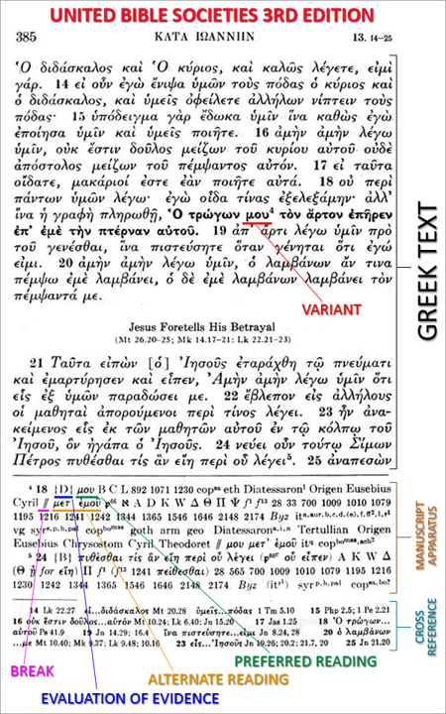

Slide 38
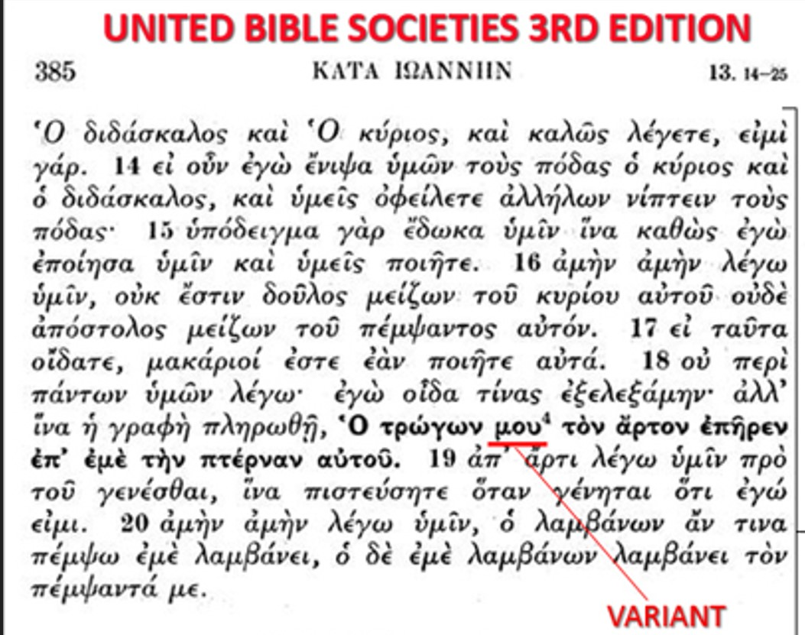

Slide 39
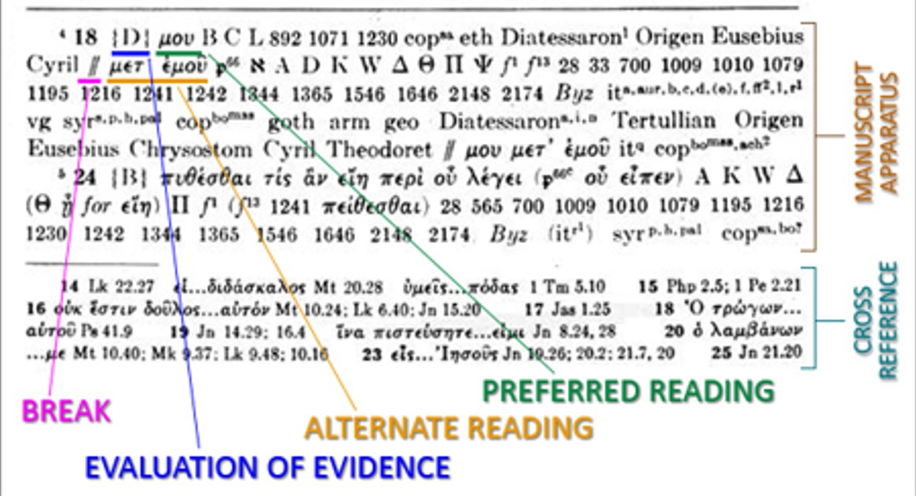

Slide 40
Miscellaneous
Triggered
I Cor. 3:18 Do not deceive yourselves. If any one of you thinks he is wise by the standards of this age, he should become a mwros so that he may become wise.
If you’ve got it, flaunt it
I Timothy 2:1-4
In business, be transparent and righteous
Notes:
In this walk, there is always someone who wants to do you harm.
Triggered
Pepper spray, Taser, Pray like Moses
Matthew 5 rain on unjust

Slide 41
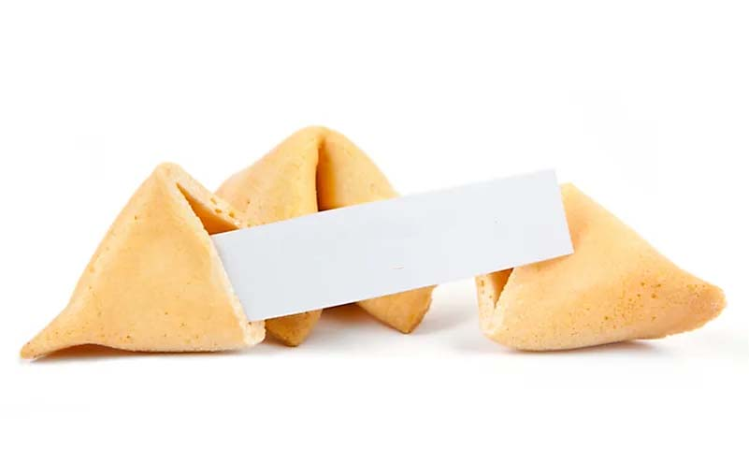
Notes:
Be sure to tell them something important

Slide 42
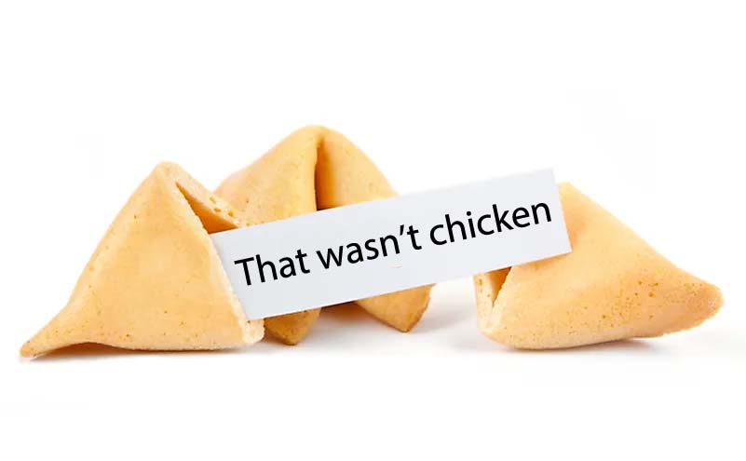

Slide 43
Miscellaneous
Living epistle or…
Evidence of God’s wisdom to the Host (Eph. 3)
Gold Standard for all humanity (w/perks)
Notes:
Gold standard – You are a representative of God
Like, if God could walk on earth, the world would look to you to learn what correct behavior is

Slide 45
Miscellaneous
Groundhog Day + the parodical son
Our Adversary: Enemy of God or Employee of the Kingdom? Short leash?
What happened to Hell?
Notes:
Job 1,2
Look at my life to see how to navigate this existence

Slide 46
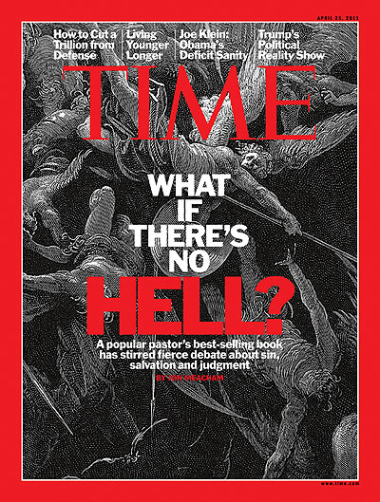

Slide 47
Summary
Personal Conviction
Is Yeshua a “Person of Interest”?
God According to God:
A Physicist Proves We've Been Wrong About God All Along: Gerald Schroeder
The Kingdom of God is invading this evil world. Do you want to be a part? Your decision: Make a “Good” decision...

Slide 48
September 28, 2010
http://hodsbs.org
48

