Slide 2
Who Are We
and
What do we Know?

Slide 3
On Tap…
Definitions
Anachronism & Syncretism
TimeLine: 3BC – Acts 10
Rome – Enemies of “their” State - Definition (Domestic Terrorism) – What did Rome do when they wanted to identify domestic terrorism?
Douglas Boin – In Search of…
Self-designations: How does this help us

Slide 4
On Tap…
After Jesus | Before Christianity
TimeLine: Acts 15 - Acts 24
Middle first century to middle second century overview
Ignatius (ECF)
P. Oxy – A new washing machine additive?
Jerome – ECF vs Peter, Paul, and Mary

Slide 5
On Tap…
Rethinking the Beginnings
Becoming Christian? Is that a good thing?
Excommunicating the Faithful…Really?
What are you taking home from this presentation?
Note: Some of this will be very difficult to accept on this first pass. Authentication is the order of the day!

Slide 6
Definitions
Anachronism
An anachronism is an event that does not belong in the time period in which it is presented.

Slide 7
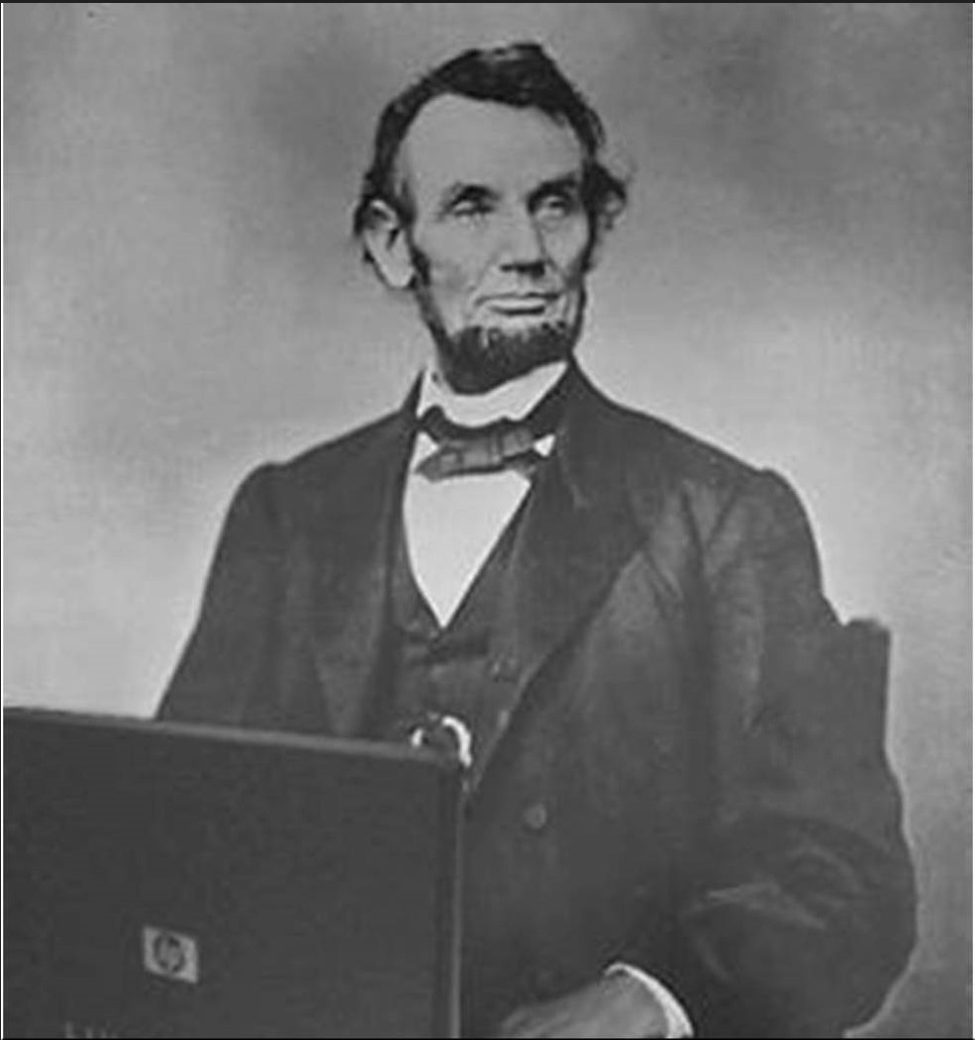

Slide 8
Definitions
Anachronism
An anachronism is an event that does not belong in the time period in which it is presented.
The Titanic - Lake Wissota 5 years
Back to the Future

Slide 10
Definitions
Anachronism
An anachronism is an event that does not belong in the time period in which it is presented.
The Titanic - Lake Wissota 5 years
Back to the Future
What about Catholicism?

Slide 11
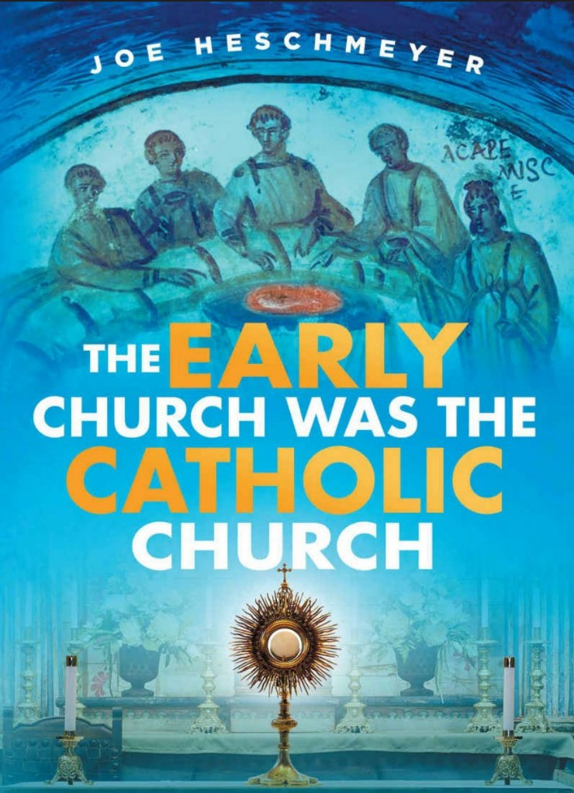

Slide 12
Definitions
Remember this definition
An anachronism is an event that does not belong in the time period in which it is presented.

Slide 13
Definitions
Syncretism
Syncretism is the name given to the blending of elements from more than one religion into a distinct system of worship.
Take heed to thyself that thou be not snared by following them…; and that thou enquire not after their gods, saying, “How did these nations serve their gods? even so will I do likewise”. Deuteronomy 12:30

Slide 14
Time Line
30 years – Tiberius (27)
Death, Resurrection, Ascent
Acts 1:6
Acts 2
Acts 9
Acts 10
Acts 11 → Domestic Terrorism

Slide 15
Domestic Terrorism
How did Rome – Enemies of “their” State
Greek “Keyword” + Latin Suffix (history)
Cristian or Cristianou,j
Adding the latin suffix equates to “Enemies of the State” (of Rome)

Slide 16
Acts 11:26
11:26c And the disciples were first called “Christians” cristianvouj in Antioch.
The Title Christianos and Roman Imperial Cult by Thomas Scott Caulley
Why were the Disciples First Called “Christians” at Antioch? By Justin Taylor
Ecole Biblique, Jerusalem 31 December 1992

Slide 17
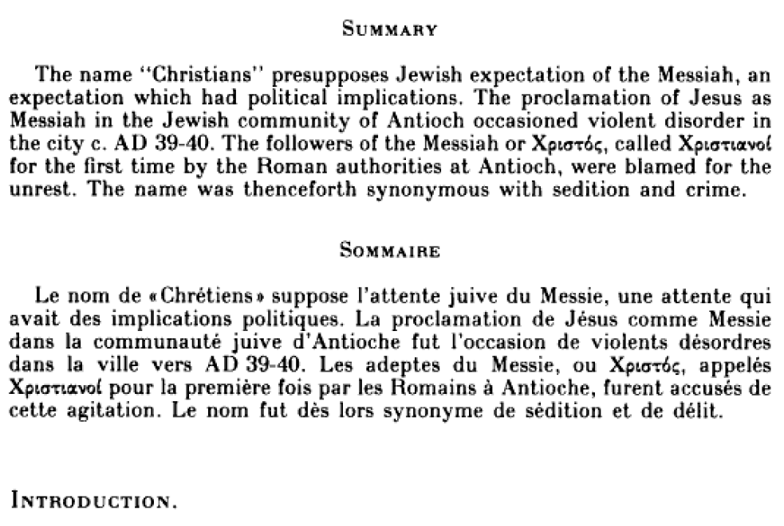

Slide 18
Acts 11:26
Why were the Disciples…
The word “Christians” presupposes Jewish Expectation of the Messiah, an expectation which had political implications.
The proclamation of Yeshua as Messiah in the Jewish community of Antioch occasioned violent disorder in the city around AD 39-40. (page 1)

Slide 19
Acts 11:26
Why were the Disciples…
The followers of the Messiah or cristoj, called cristianouj for the first time by the

Slide 20
Acts 11:26
Why were the Disciples…
The followers of the Messiah or cristoj, called cristianouj for the first time by the Roman authorities at Antioch

Slide 21
Acts 11:26
Why were the Disciples…
The followers of the Messiah or cristoj, called cristianouj for the first time by the Roman authorities at Antioch, were blamed for the unrest. The name was thenceforth synonymous with sedition and crime.
It was here that they were first called enemies of the state. (Reign of Gaius)

Slide 22
Time Line
Reviewing: Rome & Domestic Terrorism
Greek keyword: Cristianou,j
…And the disciples were first called Christians in Antioch. (Acts 11:26b)
Greek: te prw,twj evn VAntiocei,a| tou.j maqhta.j Cristianou,jÅ
The first time in Antioch the followers of Christ were called
Notes:
And first time in Antioch

Slide 23
Time Line
Reviewing: Rome & Domestic Terrorism
Greek keyword: Cristianou,j
…And the disciples were first called Christians in Antioch. (Acts 11:25b)
Greek: te prw,twj evn VAntiocei,a| tou.j maqhta.j Cristianou,jÅ
The first time in Antioch the followers of Christ were called Enemies of the State.
Notes:
And first time in Antioch

Slide 24
Time Line
Reviewing: Rome & Domestic Terrorism
Why is this an important note?
Notwithstanding the 3 occurrences of this word, let’s look at the list of what the disciples were called in the AW
Self Designations…
Notes:
And first time in Antioch

Slide 25
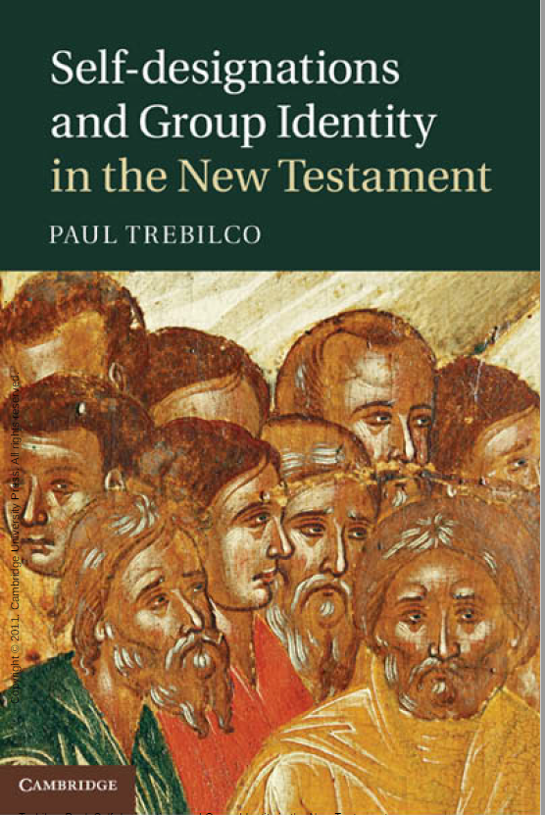

Slide 26
Self-designations
Brothers and sisters – brothers most frequently used
Believers
Saints
The Assembly
Disciples
The Way
Christian?

Slide 27
Self-designations
Brothers and sisters – brothers most frequently used
Believers
Saints
The Assembly
Disciples
The Way
Christian

Slide 28
Self-designations
Just the AW and archaeology
What terms would early ‘Christians’ have used when they addressed one another? What would they have called each other? Would they have said, ‘Are you a Christian?’ or ‘Are you a disciple?’ or ‘Are you a believer?’ How would various ‘Christian’ groups have answered the question ‘Who are we?’
And how did authors refer to members of the communities to whom they were writing, and how would these members have referred to each other?

Slide 29
Self-designations
Sect 1.3 The Term ‘Christian’
It is obvious that when we discuss ‘the earliest Christians’, we need a designation to use! Until recently, ‘Christian’ was the term that most scholars used.

Slide 30
Self-designations
Sect 1.3 The Term ‘Christian’
It is obvious that when we discuss ‘the earliest Christians’, we need a designation to use! Until recently, ‘Christian’ was the term that most scholars used. However, it is hard to avoid the charge of anachronism in the use of the term.

Slide 31
Self-designations
Sect 1.3 The Term ‘Christian’
Ana – chronistic - An anachronism is an event that does not belong in the time period in which it is presented.
Previous slide: However, it is hard to avoid the charge of anachronism in the use of the term.

Slide 32
Self-designations
Conclusion:
The word “Christian” is

Slide 33
Self-designations
Conclusion:
The word “Christian” is NEVER used in the AW in the first century as a self-designation!
Dr. Douglas Boin (Scholar and Archaeologist)
https://www.biblicalarchaeology.org/daily/archaeology-today/biblical-archaeology-topics/the-archaeological-quest-for-the-earliest-christians/
The Archaeological Quest for the Earliest Christians

Slide 34
Dr. Douglas Boin
February 01, 2018
“The race for the next spectacular artifact is on.
The assumption seems to be that if we just look a little harder, if we just dig a little bit deeper, one day, we’ll find the one piece of evidence that will take us back to the earliest age of Jesus and his followers.”

Slide 35
Dr. Douglas Boin
February 01, 2018
“To many, it’s an urgent archaeological mission with profound implications for the history of faith.
Just don’t hold your breath.
For almost two hundred years after the crucifixion, Roman cities are entirely devoid of any trace of early Christians; to date, no one has ever found any object that’s been plausibly connected to them..”
Notes:
Profound implications
Only for the faith called “Christianity”
Not for the sect of the Nazarene
What is the title of this presentation???

Slide 36
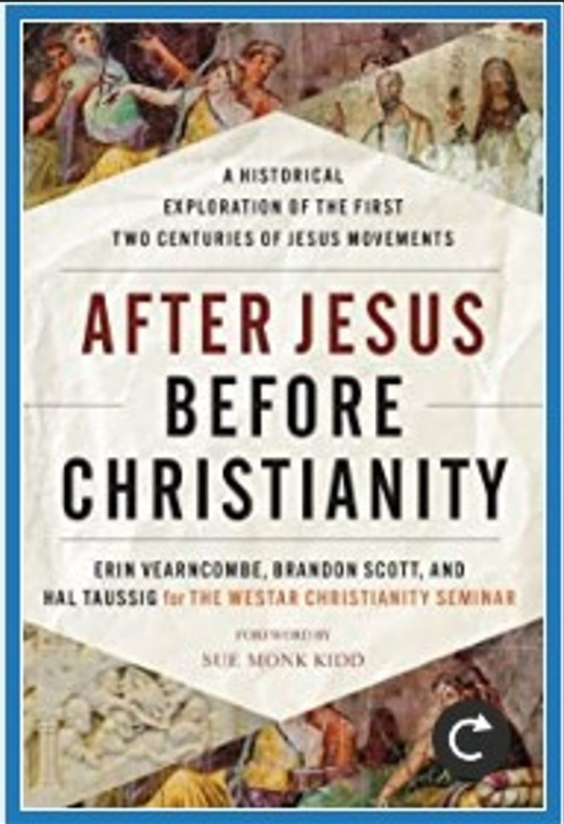

Slide 37
Time Line
Acts 15
The Didache: The Lord’s Teaching Through the Twelve Apostles to the Nations*
Acts 17:11
Acts 18-26 - English vs Greek
Aquila and Priscilla had heard,
Pri,skilla kai. VAku,laj avkou,santej
Acts 20 – Meeting in Ephesus

Slide 38
Time Line
Ephesians 20:28-30
28 Take heed therefore unto yourselves, and to all the flock, over the which the Holy Spirit hath made you overseers, to feed the Assembly of God, which he hath purchased with his own blood.

Slide 39
Time Line
Ephesians 20:28-30
29 For I know this, that after my departing shall grievous wolves enter in among you, not sparing the flock.
30 Also of your own selves shall men arise, speaking perverse things, to draw away disciples after them. (Didache)
Acts 21 – Meeting in Jerusalem

Slide 40
Time Line
Acts 21:15-20 [20]
And after those days we went up to Jerusalem. And when we had arrived, the brethren received us gladly.
And the day following Paul went in with us unto James; and all the elders were present.

Slide 41
Time Line
Acts 21:15-20 [20]
21:19 And when he had saluted them, he declared particularly what things God had wrought among the Gentiles by his ministry.
20 Seest brother how many thousands…
Qewrei/j( avdelfe,( po,sai muria,dej Rev 5:11
Tens of thousands… zealous for the Torah

Slide 42
Time Line
Acts 24:1-5, 14 [5,14]
Court case brought by High Priest and the elders of Israel.
Legal council: Tertullus
5 For we have found this man a pestilent fellow, and a mover of sedition among all the Jews throughout the world, and a ringleader of the sect of the Nazarenes:

Slide 43
Time Line
Acts 24:1-5, 14 [5,14]
What is a sect?
A separatist group characterized by loyalty to a certain school of thought and practice sect, party, sect of the Pharisees, sect of the Sadducees, sect of the Nazarenes…

Slide 44
Time Line
Acts 24:1-5, 14 [5,14]
14 But this I confess unto thee, that after the way which they call a sect, so worship I the God of my fathers, believing all things which are written in the law and the prophets.
28:22 But we desire to hear of thee what thou thinkest: for as concerning this sect, we know that every where it is spoken against.

Slide 45
Time Line
From Acts 24 and 28, we see the believers are a sect of Israel, based on the writings of Moses and the prophets.
Jerusalem (like Acts 15) still had Jewish bishops (15) up until 135 AD.
After the Bar Kokhba incident, all bishops going forward would be Gentile.
Hadrian wanted to eradicate Judaism.

Slide 46
Ignatius
Bishop early second century
First occurrence of the word “Christian” as a definer.
Excerpts from his letter to the Magnesians
Translated by Cyril Richardson
4 We are not only to be called Christians, but to be Christians

Slide 47
Ignatius
6 Let the bishop preside in God’s place
Let the presbyters take the place of the apostolic council…
7 You must not do anything without the bishop and presbyters
8 Do not be led astray by wrong views or by outmoded tales that count for nothing. For if we still go on observing Judaism, we admit we never received grace.

Slide 48
Ignatius
9 Those, then, who lived by ancient practices arrived at a new hope. They ceased to keep the Sabbath…
10 Hence, now we must learn to live like Christians.
Get rid, then, of the bad yeast — it has grown stale and sour…

Slide 49
Ignatius
10 It is monstrous to talk Jesus Christ and to live like a Jew.
For Christianity did not believe in Judaism, but Judaism in Christianity.
11 I want to caution you, lest you fall prey to stupid ideas…
And so it begins…

Slide 50
P. Oxy 840
Papyrus Oxyrhynchus 840
The Gospel of the Savior
Relationship between the “continued Jewish” followers (now removed from Jerusalem after the Bar Kokhba revolt) and Rabbinic Judaism that has consolidated all the sects except the Sect of the Nazarene.

Slide 51
Next 2 Centuries
P. Oxy 840 group continues including new writings (like the commentary on Isaiah)
The beginning of the formation of Christianity and the removal of key parts of Moses and the prophets
Polycarp & Polycrates
The transition from the teachings of the Torah to a syncretized pagan belief system

Slide 52
4th Century
Review: Anachronism
An anachronism is an event that does not belong in the time period in which it is presented.
Was “Christianity” really in the first century?
What did the later ECFs call the first believers?

Slide 53
Epiphanius P.29
They did not call themselves ‘Christians’, but Nazarenes . . . they remained wholly Jewish and nothing else. For they use not only the NT but also the Old like the Jews.
They live according to the preaching of the Law as among the Jews.
Late 4th century after Constantine is long dead and gone

Slide 54
Jerome L.75
“The Nazarenes… accept Messiah in such a way that they do not cease to observe the old Law.”
“Though believing in Christ, [they] were denounced and cursed by the ECFs for this one error, that they professed their faith in that which was new (Christ), without letting go of what was old (the law)..”

Slide 55
Constantinople
I renounce all customs, rites, legalisms, unleavened breads & sacrifices of lambs of the Hebrews, and all other feasts of the Hebrews, sacrifices, prayers, aspersions, purifications, sanctifications and propitiations and fasts, and new moons, and Sabbaths, and superstitions, and hymns and chants and observances and Synagogues, and the food and drink of the Hebrews;

Slide 56
Constantinople
In one word, I renounce everything Jewish, every law, rite and custom and if afterwards I shall wish to deny and return to Jewish superstition, or shall be found eating with the Jews, or feasting with them, or secretly conversing and condemning the Christian religion instead of openly confuting them and condemning their vain faith…

Slide 57
Constantinople
then let the trembling of Gehazi cleave to me, as well as the legal punishments to which I acknowledge myself liable. And may I be anathema (cursed by the pope) in the world to come, and may my soul be set down with Satan and the devils.

Slide 58
Summary
Excommunicating the Faithful…Really?
Jeremiah 6:16
Thus saith Yahweh, “Stand ye in the ways, and see, and ask for the old paths, where is the good way, and walk therein, and ye shall find rest for your souls.”
Who are we (really) and what do we know? You’ll need to decide that for yourself.

Slide 59
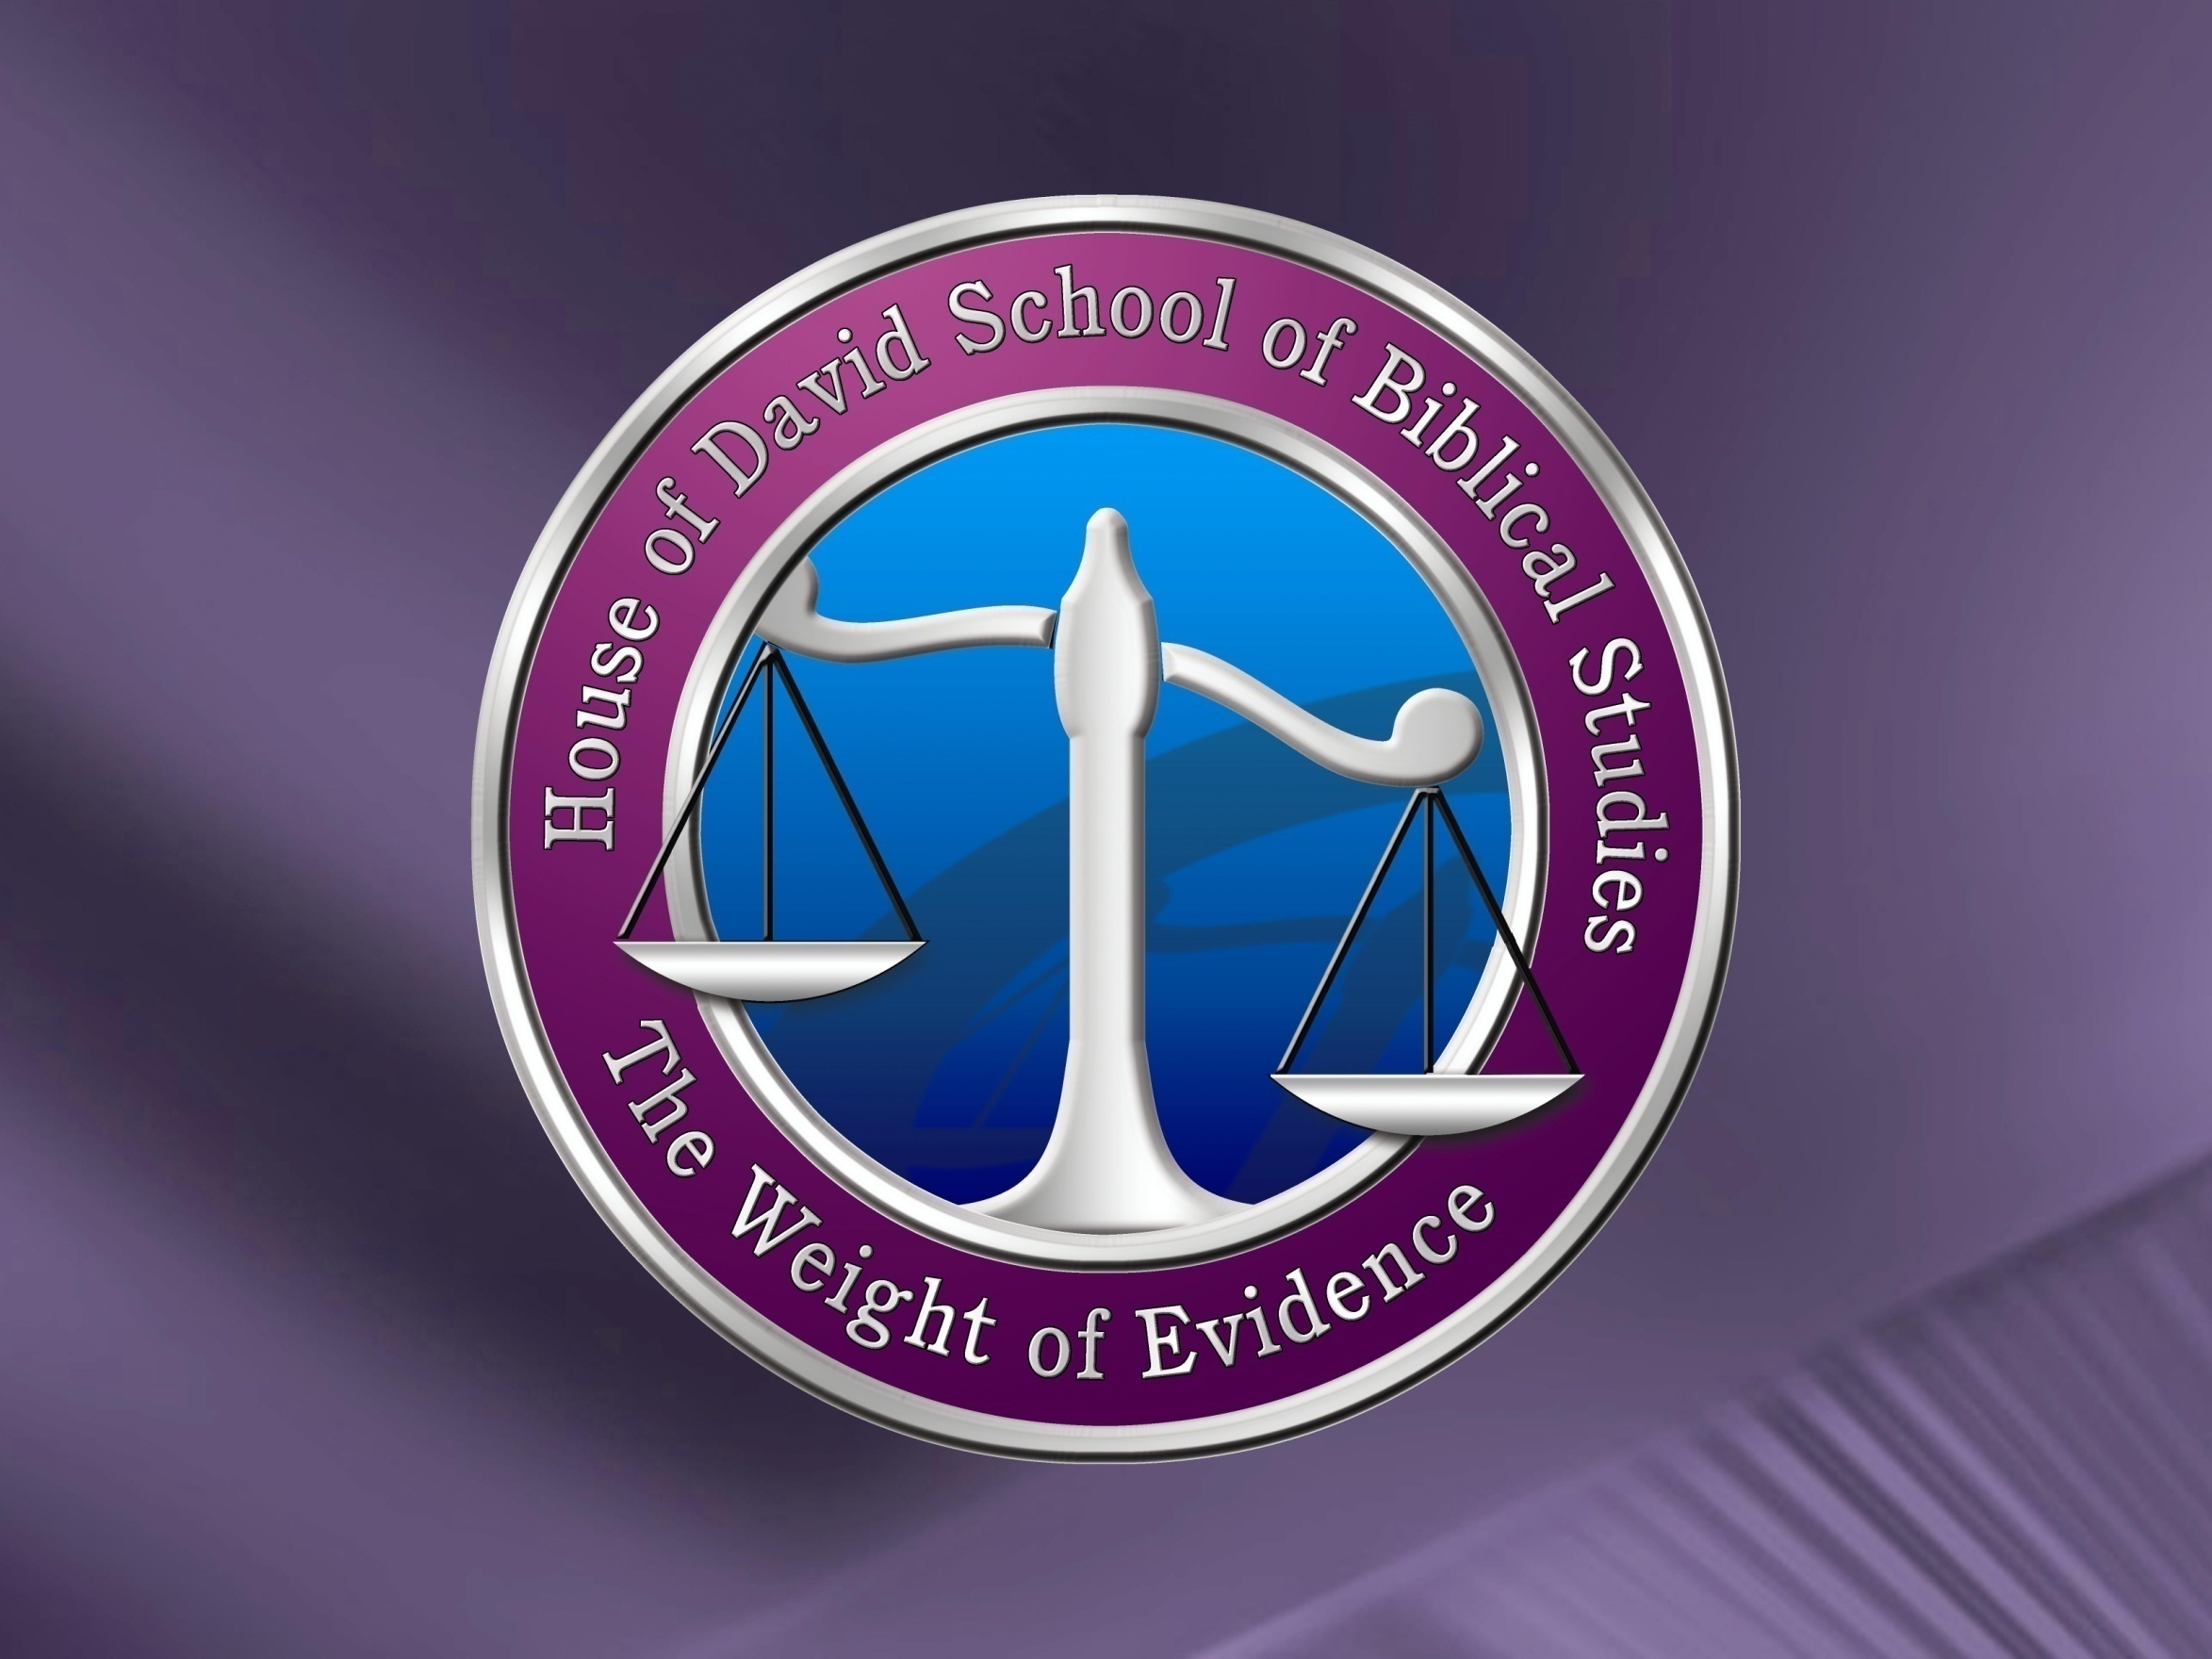
September 28, 2010
http://hodsbs.org
59

