Slide 2
Review
Clement of Rome*
Dr. Phillip Carrington and Mark

Slide 3
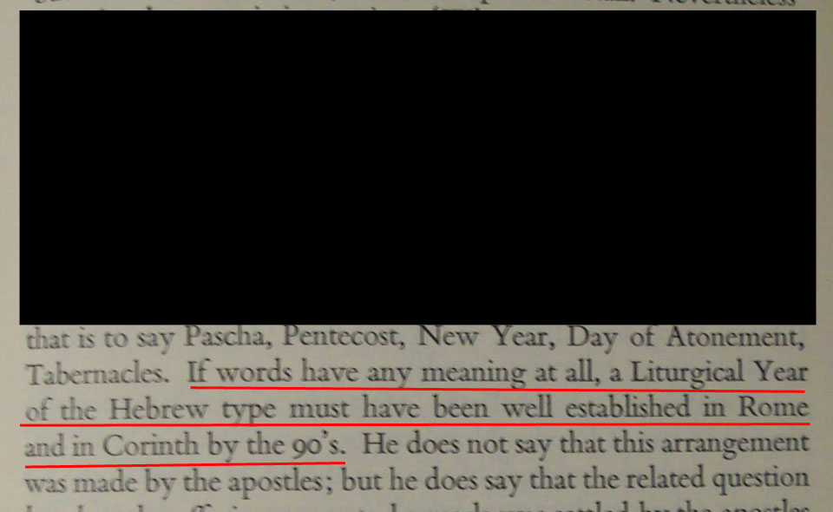
Whatever the Lord has commanded us to perform, we ought to do in accordance with the appointed seasons. He commanded the offerings and services to be performed conscientiously and not at random or without order, but at appointed seasons and hours.

Slide 4
Since Clement goes on to refer to the high priests, the priests, and the Levites, it is clear that the ‘appointed seasons’ which he regards as essential must be those of the Levitical Law.

Slide 5
If words have any meaning at all, a Liturgical Year of the Hebrew type must have been well established in Rome and Corinth by the 90's.
Page 41

Slide 6
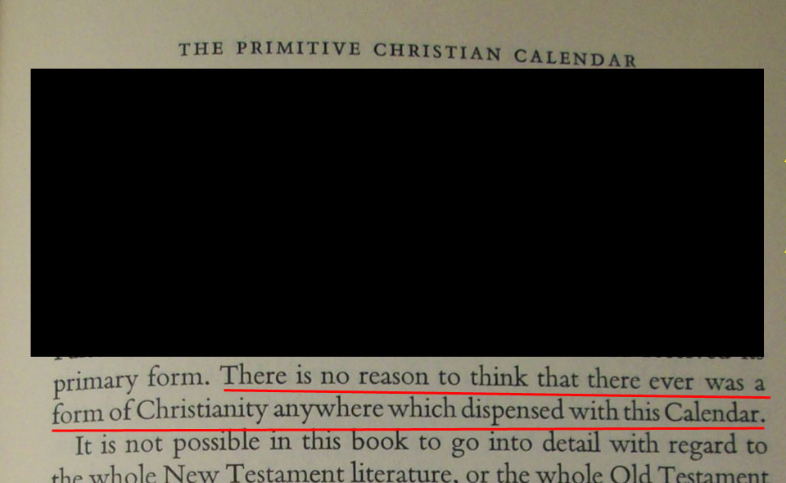
There is no reason to think that there ever was a form of Christianity anywhere which dispensed with this Calendar. Page 43

Slide 7
Sacrifices
Worship in the Jerusalem Temple after A. D. 70 by K. W. Clark in New Testament Studies, #6, (1959-60), pp, 269-280
The Temple and Sacrifice in Rabbinic Judaism by J. R. Brown in (Evanston: 1963, Winslow Lectures for 1963).

Slide 8
Review
Clement of Rome
Dr. Phillip Carrington and Mark*

Slide 9
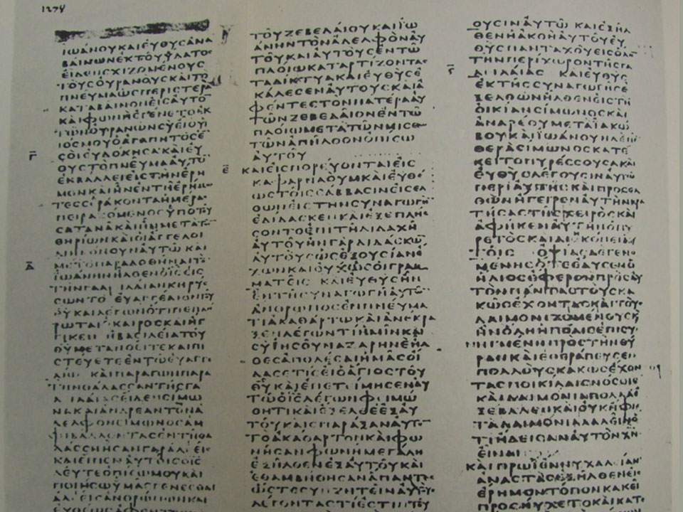

Slide 10
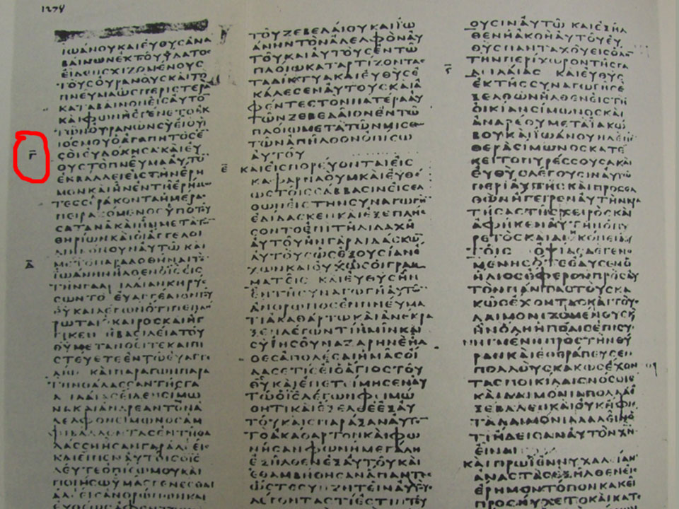

Slide 11
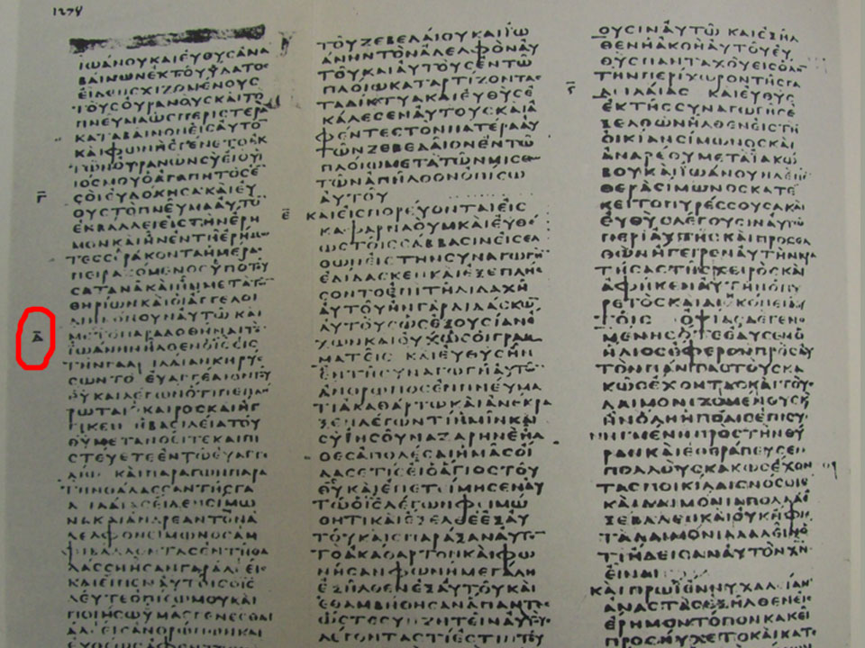

Slide 12
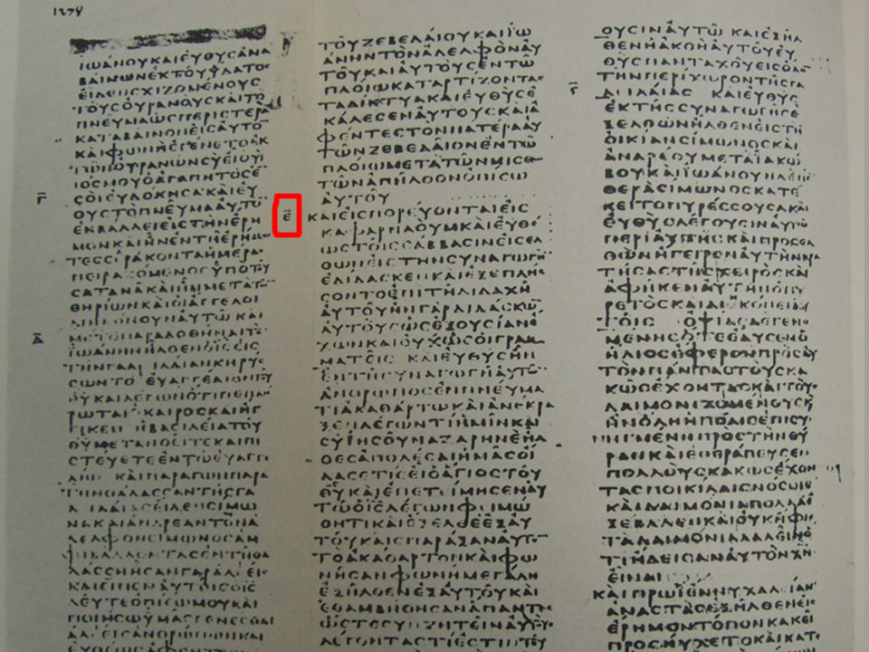

Slide 13
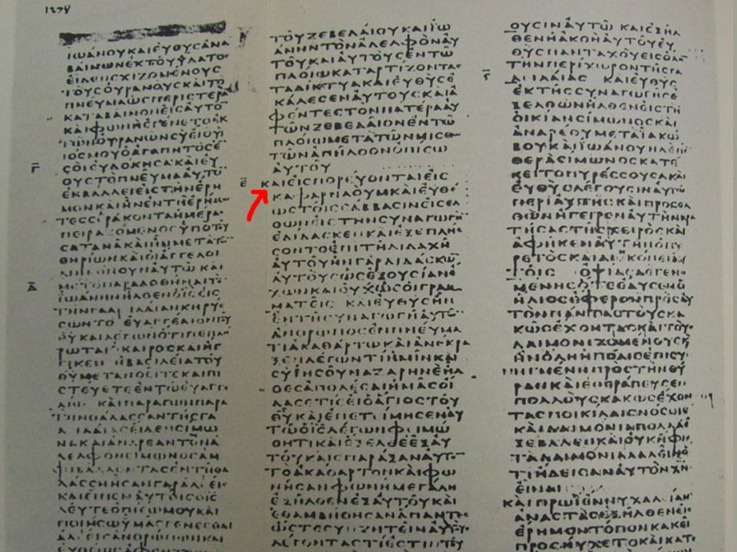

Slide 14
Paul’s Perspective - II Timothy 3:15
“And that from a child thou hast known the Holy Scriptures, which are able to make thee wise unto salvation through faith which is in Yeshua the Messiah.”

Slide 15
Paul’s Perspective - II Timothy 3:16
“All Scripture is God breathed and is profitable for learning…
Teaching… (What is right)
Reproof… (What is not right)
Correction… (How to get it right)
Instruction in right-living (How to keep it right)

Slide 16
The Microscope of Reality
The Timeline

Slide 17
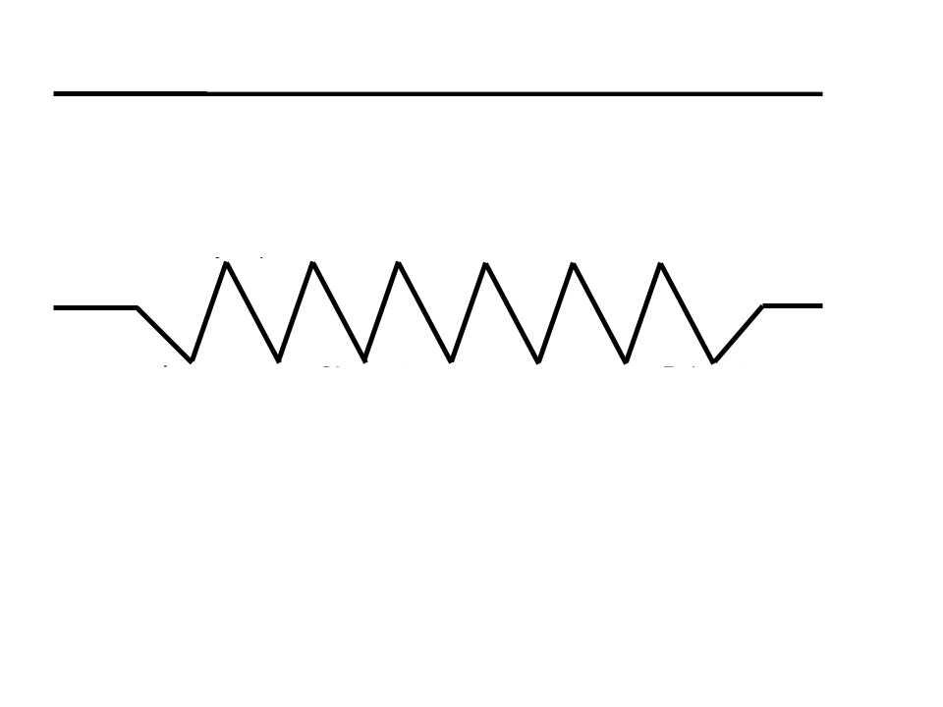

Slide 18
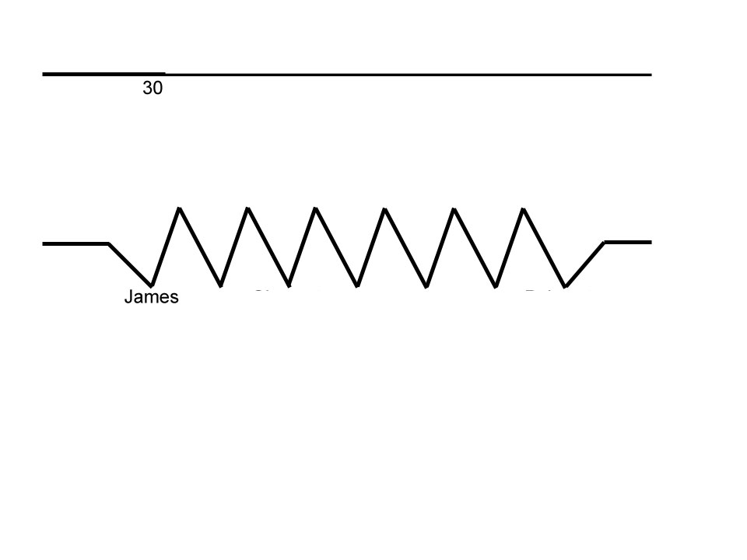

Slide 19
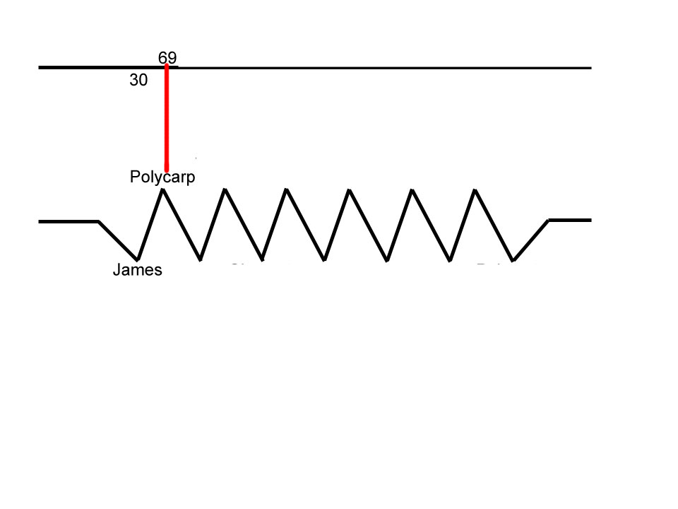
Studied under the Apostle John for 20 years

Slide 20
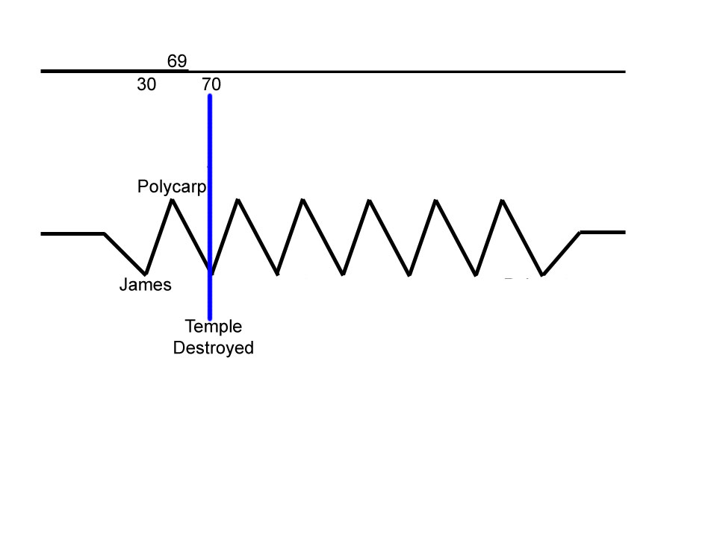

Slide 21
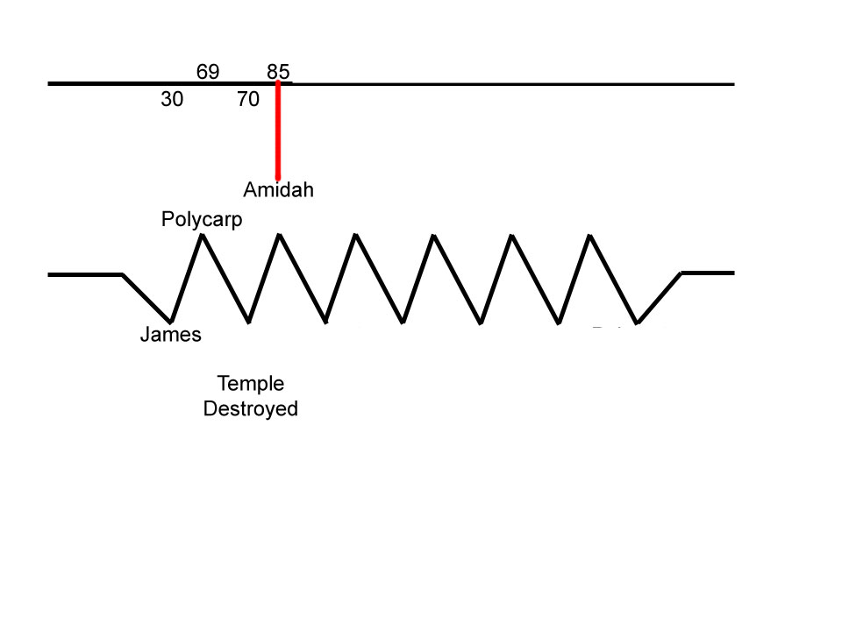

Slide 22
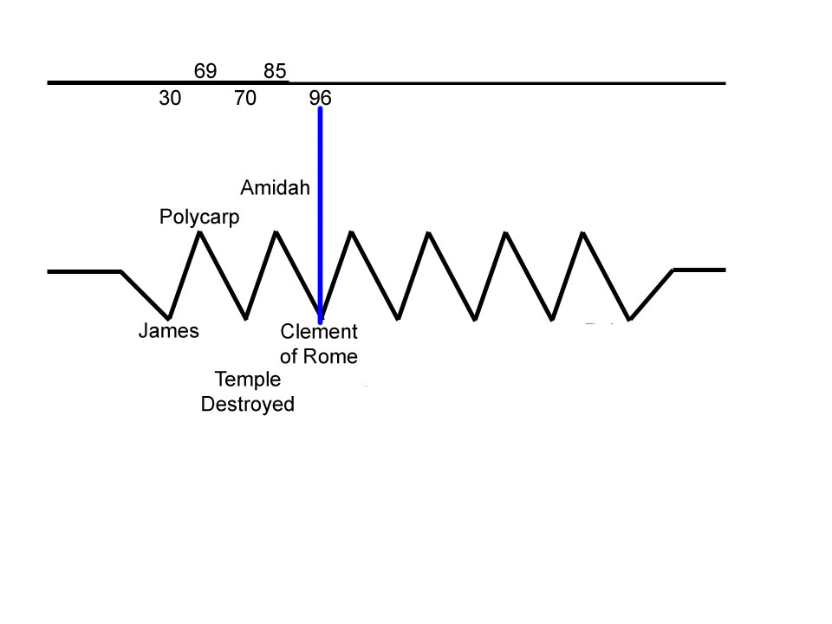
Sacrifices and the Levites

Slide 23
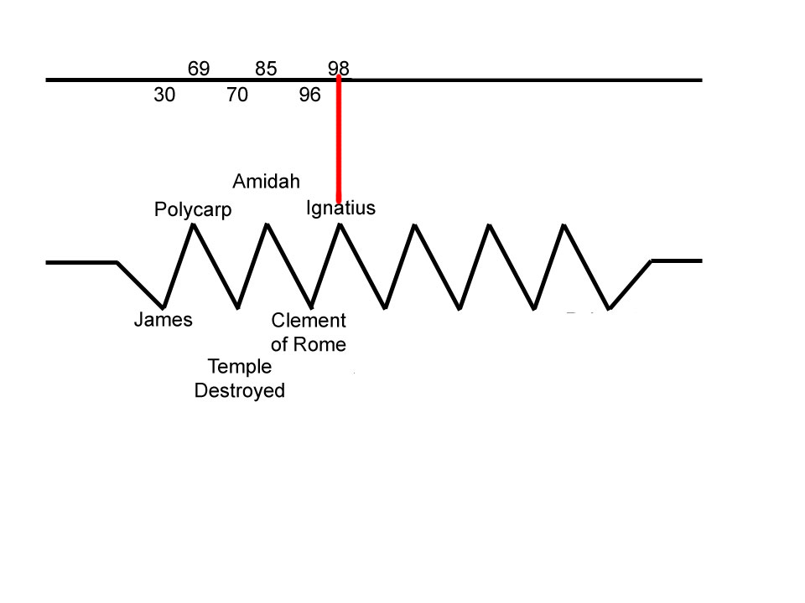

Slide 24
Ignatius to the Magnesians
8.1 Be not seduced by strange doctrines nor by antiquated fables, which are profitless.
8.2 For if even unto this day we live according to the manner of Judaic concepts, we admit that we have not received grace: for the Godly prophets lived the way Yeshua did.

Slide 25
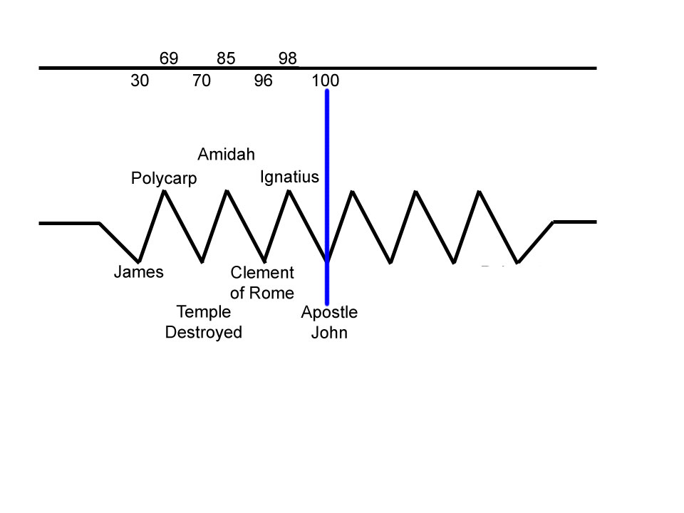
Two quotes

Slide 26
Eusebius
“…after the tyrant's death, he [John] returned from the isle of Patmos to Ephesus, he went upon their invitation to the neighboring territories of the Gentiles, to appoint bishops in some places, in other places to set in order whole churches, elsewhere to choose to the ministry some one of those that were pointed out by the Spirit...”

Slide 27
Eusebius
Eusebius. Church History, Book III, Chapter 23. Translated by the Rev. Arthur Cushman McGiffert. Excerpted from Nicene and Post-Nicene Fathers, Series Two, Volume 1. Edited by Philip Schaff and Henry Wace. American Edition, 1890. Online Edition Copyright © 2004 by K. Knight.

Slide 28
Iraeneaus
“…the Church in Ephesus, founded by Paul, and having John remaining among them permanently…, is a true witness … of the Apostles.
Irenaeus. Adversus Haereses. Book III, Chapter 3, Verse 4, p. 416

Slide 29
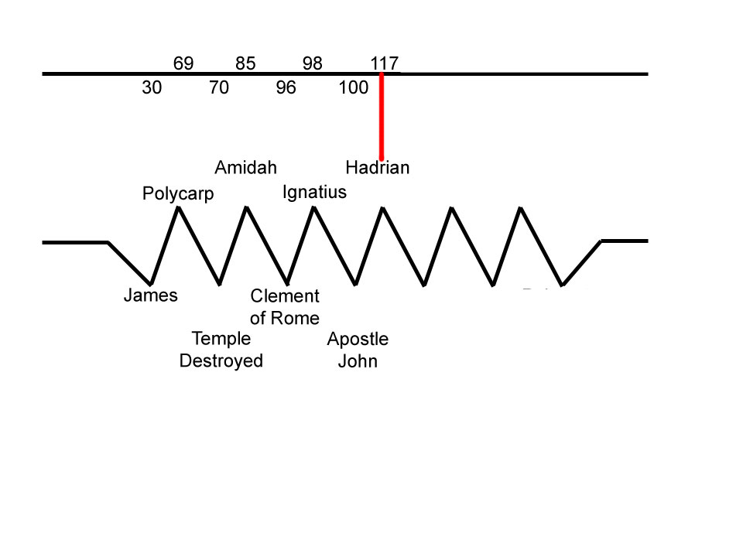
Do away with anything “Jewish”.

Slide 30
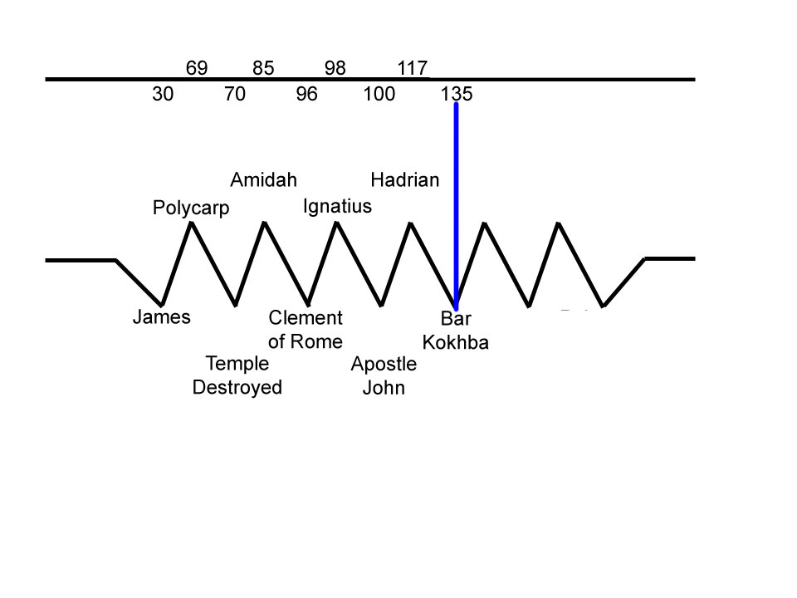
Follow the false messiah or treason.

Slide 31
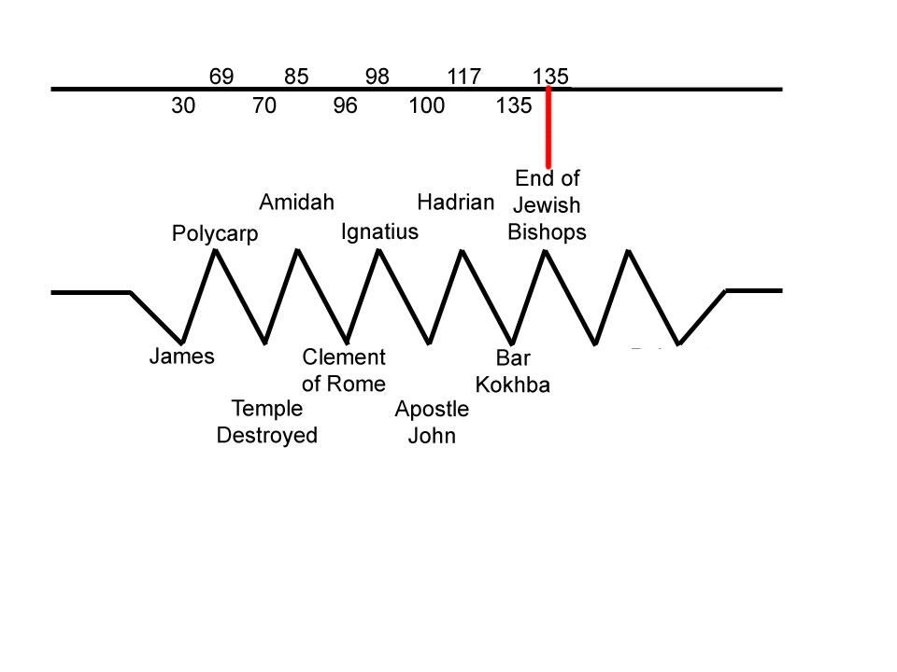

Slide 32
The Jewish Bishops
The first fifteen bishops of Jerusalem were all circumcised Jews; and the congregation over which they presided united the law of Moses with the doctrine of Christ.
It was natural that the primitive tradition of a church which was founded only forty days after the death of Christ, and was governed almost as many years under the immediate inspection of his apostle, should be received as the standard of orthodoxy.

Slide 33
The Jewish Bishops
It has been remarked that the virgin purity of the church was never violated by schism or heresy before the reign of Trajan or Hadrian, about one hundred years after the death of Christ.
Decline and Fall of the Roman Empire, Volume I, Chapter XV, Section I. ca. 1776-1788 Gibbon E.

Slide 34
The Jewish Bishops
The Jewish Christians, at least in Palestine, conformed as closely as possible to the venerable forms of the cultus of their fathers, which in truth were divinely ordained, and were an expressive type of the Christian worship.

Slide 35
The Jewish Bishops
So far as we know, they scrupulously observed the Sabbath, the annual Jewish feasts, the hours of daily prayer, and the whole Mosaic ritual.
History of the Christian Church, Chapter 9. Oak Harbor, WA: Logos Research Systems, Inc. 1997 by Philip Schaff

Slide 36
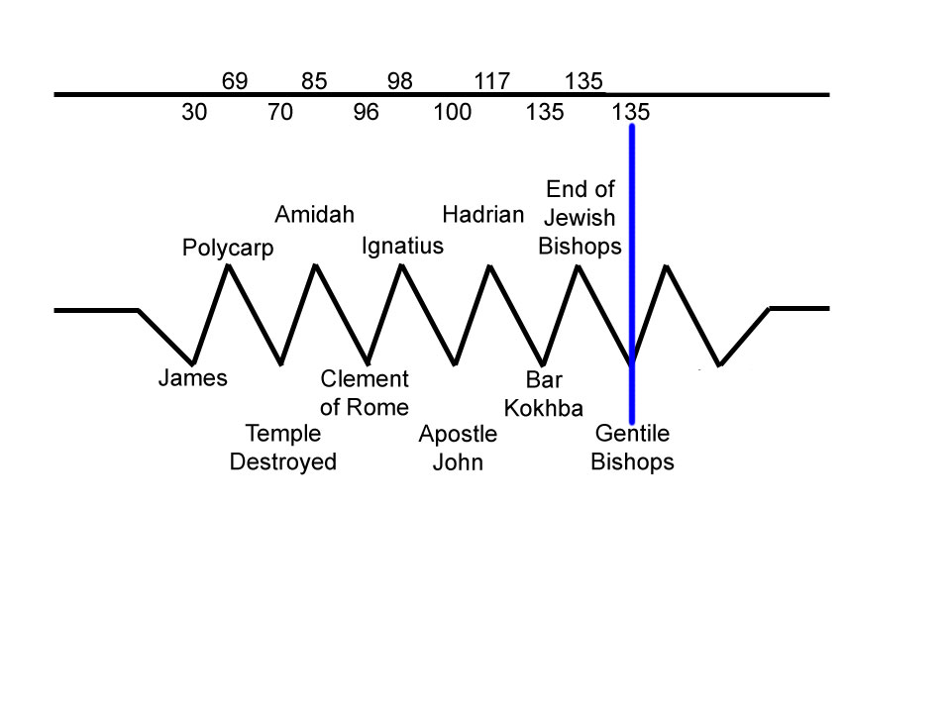

Slide 37
The Gentile Bishops
Decline and Fall of the Roman Empire
They elected Marcus for their bishop, a prelate of the race of the Gentiles, and most probably a native either of Italy or of some of the Latin provinces.

Slide 38
The Gentile Bishops
At his persuasion the most considerable part of the congregation renounced the Mosaic law, in the practice of which they had persevered above a century. By this sacrifice of their habits and prejudices they purchased a free admission into the colony of Hadrian.

Slide 39
The Gentile Bishops
[Prior to this action], “the Jewish Bishops insisted on the literal observance of the Law.”

Slide 40
The Gentile Bishops
Eusebius. Church History, Book IV, Chapter 5, Translated by Arthur Cushman McGiffert. Excerpted from Nicene and Post-Nicene Fathers, Series Two, Volume 1. Edited by Philip Schaff and Henry Wace. American Edition, 1890. Online Edition Copyright © 2004 by K. Knight

Slide 41
The Gentile Bishops
But I have learned this much from writings, that until the siege of the Jews, which took place under Adrian, there were fifteen bishops in succession there, all of whom are said to have been of Hebrew descent.

Slide 42
The Gentile Bishops
They received the knowledge of Christ in purity, so that they were approved by those who were able to judge of such matters, and were deemed worthy of the episcopate.

Slide 43
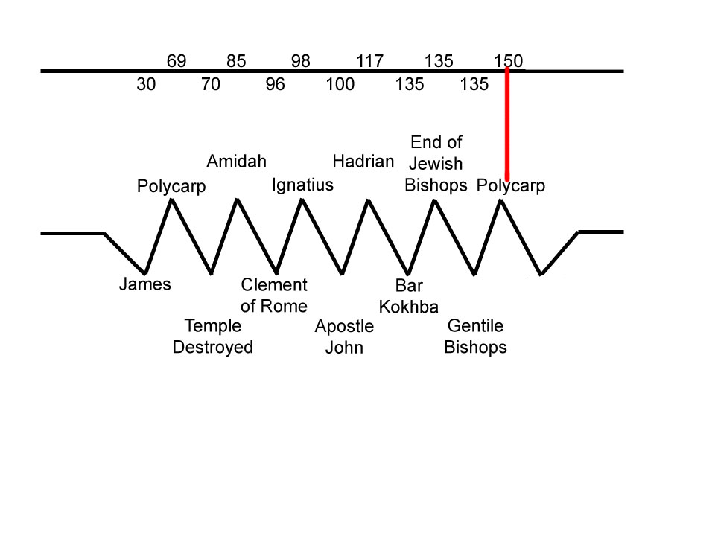

Slide 44
Polycarp and Paul
Polycarp wrote an epistle to the Philippians where he spoke in the most glowing and excellent terms concerning Paul.

Slide 45
Polycarp vs Anicetus 150 c.e.
“And when the blessed Polycarp was at Rome in the time of Anicetus [approx. 150+], and they disagreed a little about certain other things [besides when to observe Passover], they immediately made peace with one another, not caring to quarrel over this matter.

Slide 46
Polycarp vs Anicetus 150 c.e.
For Anicetus could not persuade Polycarp to stop observing what he had always observed with John the disciple of our Lord, and the other apostles with whom he had associated;

Slide 47
Polycarp vs Anicetus 150 c.e.
And Polycarp couldn’t persuade Anicetus to observe it as he (Anicetus) said that he ought to follow the customs of the presbyters that had preceded him [no matter what the Apostles taught and handed down].”

Slide 48
Can we date this?
Epiphanius - “. . . the controversy arose after the exodus of the bishops of the circumcision (135) and it has continued until our time (315 - 403).”

Slide 49
Epiphanius
He then makes reference to the 15 bishops.
They kept the 14th day of the first month as also found in the Apostolic Constitutions.

Slide 50
Epiphanius
He then quotes the following rule found in the A.C.
“You [Gentile Christians] ought to celebrate Passover at the same time as your brethren who from the circumcision have entered the church.”

Slide 51
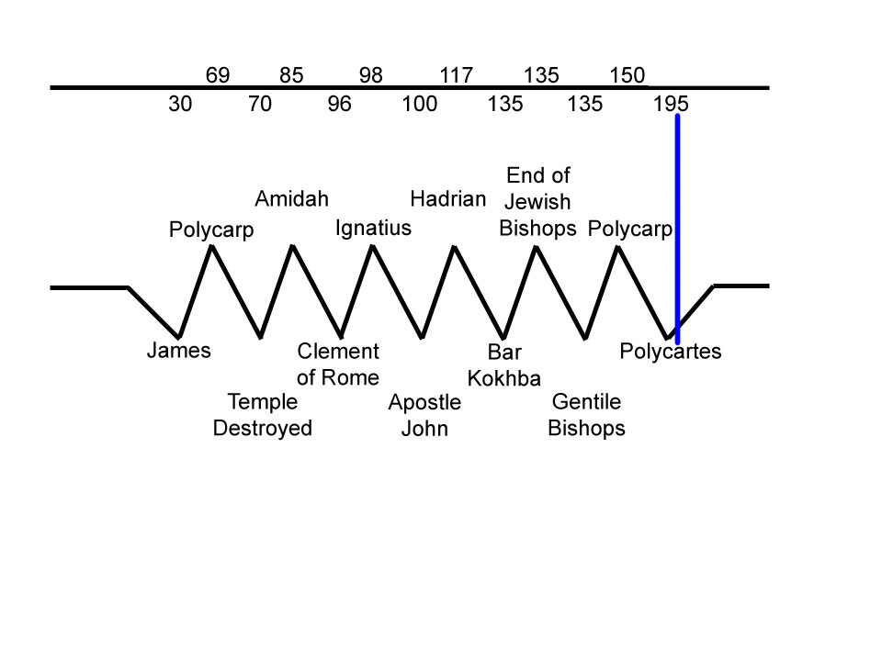

Slide 53
Polycrates: Background
130-196
Presided over a synod of Asiatic bishops to codify the Roman Easter because a divergent method existed.
Bishop Victor of Rome requested this meeting…

Slide 54
Polycrates - The Letter
“[Concerning Passover]
We scrupulously observe the exact day; neither adding, nor taking away.

Slide 55
Polycrates - The Letter
For in Asia also great lights have fallen asleep. Among these are the Apostles Philip and John, Polycarp, and others.

Slide 56
Polycrates - The Letter
All these observed the 14th day of the Month, in accordance with the Gospel, deviating in no respect, but following the rule of faith.

Slide 57
Polycrates - The Letter
For seven of my relatives were bishops; and I am the eighth.

Slide 58
Polycrates - The Letter
And my relatives ALWAYS observed the day when the people put away the leaven.

Slide 59
Polycrates - The Letter
I have met with the brethren throughout the world, and have gone through every Holy Scripture.

Slide 60
Polycrates - The Letter
I could mention the bishops who were present, whom I summoned at your desire; whose names […] would constitute a great multitude. And they gave their…
UNANIMOUS consent to the letter.”

Slide 61
Polycrates - The Letter
I am not frightened at the things which are said to terrify us. For those who are greater than I have said, “We ought to obey God rather than men”.

Slide 62
Polycrates: Summary Claims
Follower of teachings of the Apostles
Faithful to teachings of the Gospel (which includes the Torah)
Obeying God’s Word was more important than following a man’s tradition
The evidence of the Biblical imprint passed down from the Jerusalem assembly does not stop with Polycrates

Slide 63
(Insert) The Jerusalem Imprint
Bardesane (180-223)
“My disciples sanctify Sunday and not Saturday and they do not practice circumcision ‘as the Christians’ in Judea.”
From Bagatti, L’Eglise, pp. 8,9

Slide 64
What was Victor’s Decision
Excommunicate Them
Iraeneaus (who was on Victor’s side) wrote to Victor and rebuked him.
So then what did Victor do?

Slide 65
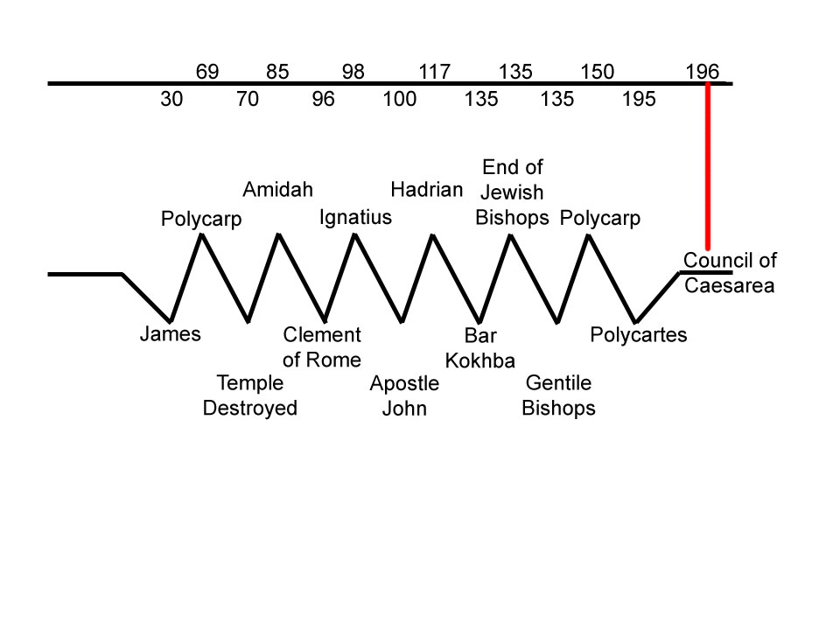

Slide 67
This Picture Has Emerged
Apostles setup feast calendar Col 2, 1Cor 5
Mark = Deut. 18:18-19 – w/Torah Readings
Amidah
Clement in Rome
Bar Chova’s revolt
No more Jewish leadership in Jerusalem church which leads to…
Removal of Torah Observance and Power Transfer to Rome

Slide 68
The Jewish Bishops (again)
They received the knowledge of Christ in purity, so that they were approved by those who were able to judge of such matters, and were deemed worthy of the episcopate.

